Slide 1
NEFI – GHG emissions goals
Kevin Grant
November 5, 2019

Slide 2
Discussion points
Historical Greenhouse Gas Emissions
Estimated GHG targets vs. NEFI goals
Renewable heating oil blend scenarios
Path to achieving goals and potential obstacles
Framing the debate on liquid heating fuels

Slide 3
Greenhouse Gas Emissions
https://www.epa.gov/sites/production/files/2019-04/documents/us-ghg-inventory-2019-main-text.pdf

Slide 4
EPA GHG figures for 1990 and 2017
GHG Emissions by sector

Slide 5
EPA GHG figures for 1990 and 2017
Comparison of total GHG for all sectors vs. residential only

Slide 6
GHG gas reductions by product
Lifecycle Analysis Greenhouse Gas Results for Select Pathways (kg CO2e per mmBtu)
Feedstock | Fuel | Production Process | Percent Reduction
Algal oil | Biodiesel | Transesterification (Open Pond, Mid) | 66%
Algal oil | Biodiesel | Transesterification (PBR, Mid) | 71%
Barley | Ethanol | Dry Mill (<36,800 Btu/gal NG, <0.19 kWh/gal Elec.) | 51%
Barley | Ethanol | Dry Mill NG | 47%
Biogas from landfills | Renewable electricity | Any | 87%
Canola oil | Biodiesel | Transesterification | 50%
Cellulose from corn stover | Cellulosic diesel | Fischer-Tropsch process | 91%
Cellulose from corn stover | Ethanol | Biochemical enzymatic process | 129%
Corn starch | Butanol | Dry Mill Biomass (dry DDGS) | 50%
Corn starch | Butanol | Dry Mill NG Base Plant (dry DDGS) | 27%
Corn starch | Butanol | Wet Mill Coal | 8%
Corn starch | Ethanol | Dry Mill Biomass (2022 Average) | 38%
Corn starch | Ethanol | Dry Mill NG (2022 Average) | 21%
Corn starch | Ethanol | Wet Mill Coal | -19%
Grain sorghum | Ethanol | Dry Mill, 92% Wet DGS, Biogas, CHP | 53%
Grain sorghum | Ethanol | Dry Mill, Dry DGS, NG | 22%
Palm oil | Biodiesel | Transesterification | 17%
Palm oil | Renewable diesel | Hydrotreating | 11%
Soybean oil | Biodiesel | Transesterification | 57%
Sugarcane | Ethanol | Fermentation (Trash, No CBI, Marg. Elec.) | 91%
Sugarcane | Ethanol | Fermentation (No Trash, No CBI, Marg. Elec.) | 61%
Switchgrass | Cellulosic diesel | Fischer-Tropsch process | 71%
Switchgrass | Ethanol | Biochemical enzymatic process | 110%
Switchgrass | Ethanol | Thermochemical gasification process | 72%
Yellow grease | Biodiesel | Transesterification | 86%
Petroleum | Baseline Gasoline | Refining | 0%
Petroleum | Baseline Diesel | Refining | 0%
https://www.epa.gov/fuels-registration-reporting-and-compliance-help/lifecycle-greenhouse-gas-results

Slide 7
Bio blends required to hit targets
15% GHG reductions from 1990 levels
15% GHG reductions from 1990 residential levels

Slide 8
Bio blends required to hit targets
40% GHG reductions from 1990 residential levels

Slide 9
Northeast biodiesel volume requirements to meet GHG reduction goals

Slide 10
Necessary steps to achieve goals
1) Capital Investment
Expansion of production / transport / storage assets
Third party blending facilities in major ports
Shipping companies addition of bio barges
Increase in rail infrastructure and trucking capacity
2) Access to waterborne
Availability of domestic and European material
“We are going to need a bigger boat...”
Access to Argentina biodiesel
3) Increased regional production
Local production currently has limited elasticity
2020 - 2021 start dates necessary to meet goals
4) Combined efforts to meet targets
Reseller and wholesaler blending
Lobbying coordination on bio tax credit

Slide 11
Additional issues
Pipelines
Jet line / Colonial
Stranded terminals
Petroleum supply from non RFS locations
Canadian vessels and rail (VT)
Heating oil imports during peak periods
Common sense rules
Managing the increase in cost
Storage costs – heating / segregation
Possible decrease in loading locations
Bio premiums in short market
New Products
Blend stocks with lower GHG profile likely to be required
Adjusting to change in traditional heating oil supply chain

Slide 12
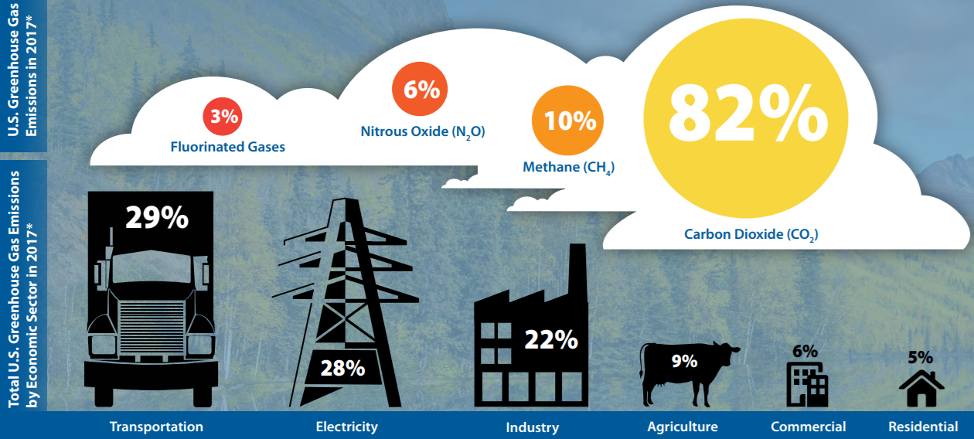
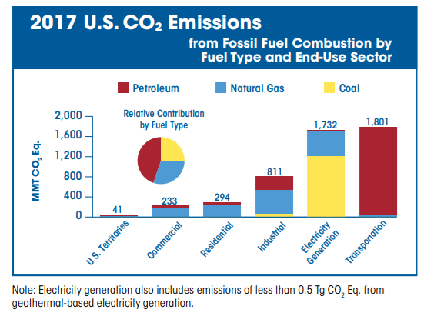
GHG emissions by sector in U.S.

Slide 13
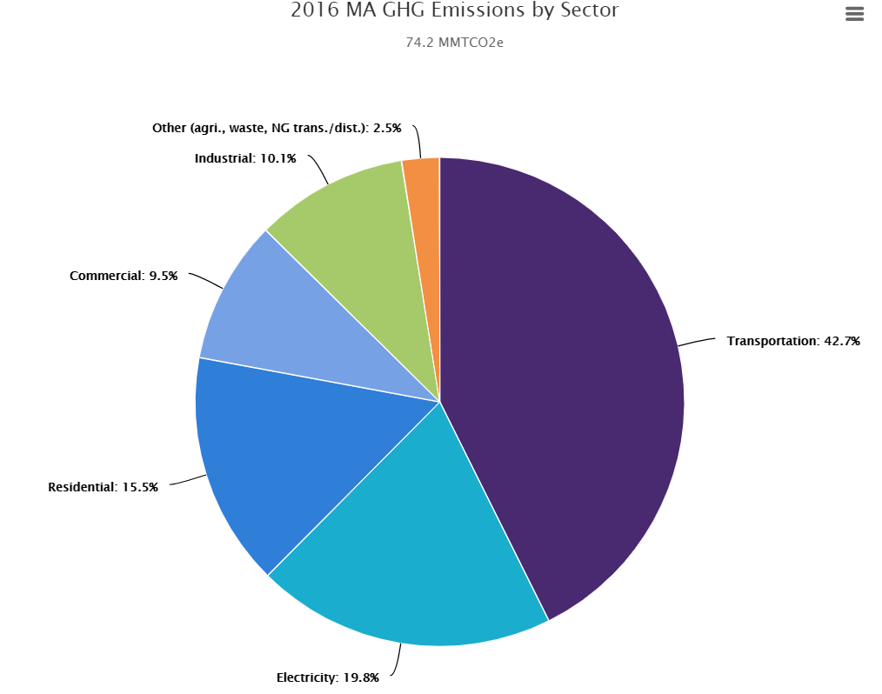
Massachusetts emissions by sector
Massachusetts Household Heating
Fuel Type | # of Households | Percentage
utility gas | 1,321,175 | 50.6%
bottled, tank, LP | 83,401 | 3.2%
electricity | 395,373 | 15.3%
fuel oil, kerosene | 707,835 | 27.4%
coal or coke | 2,851 | 0.1%
wood | 40,176 | 1.6%
solar | 1,984 | 0.08%
other fuel | 20,025 | 0.8%
no fuel | 12,895 | 0.5%
total | 2,585,715
http://www.mass.gov/eea/docs/dep/air/climate/1990-2020-final.pdf

Slide 14
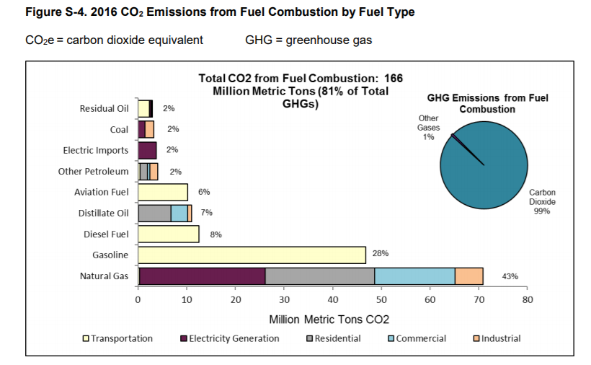
New York State GHG Emissions
NYSERDA - New York State Greenhouse Gas Inventory: 1990–2016 Final Report | July 2019

